Slide 1
Polarimetric Image Classification using Unsupervised & Supervised ML
Group members:
Akash Barad-IEC2019050
Vignesh-IEC2019076
Udhav Rana-IEC2019086

Slide 2
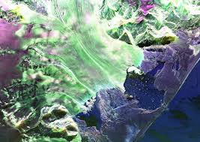
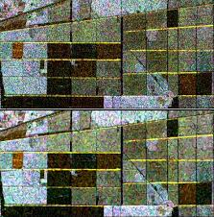
Introduction
Polarimetry images has been highly in use for monitoring of Earth's surface.
Concepts of polarimetry and its diverse applications:
Disaster Preparation & Response
Search & Rescue Operations
Counter Drug Trafficking Operations
Military Surveillance
Border Security
Infrastructure Monitoring.

Slide 3
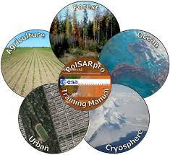
Motivation
The surface of the Earth cannot be imaged with visible or infrared sensors when there are clouds .
Microwaves can penetrate through clouds and vegetation, and can operate in day or night conditions .
Advantages of Polarimetric Images:
Nearly all weather capability
Day or night capability
Penetration through the vegetation canopy
Penetration through the soil
Minimal atmospheric effects

Slide 4
Existing Decomposition Theorems:
Coherent Decomposition technique:
Pauli’s decomposition
Lexicographic decomposition
Incoherent Decomposition Technique:
Eigenvector-based decomposition
Model-based decomposition:
Freeman Decomposition
Yamaguchi Decomposition

Slide 5
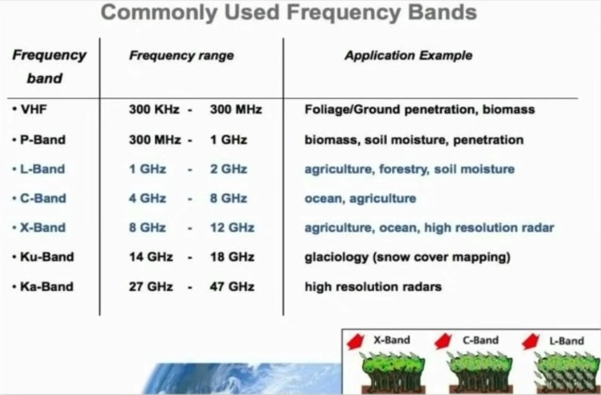
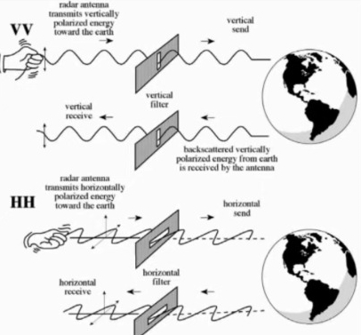
Radar Image Formation and signal Interaction
Radar can measure amplitude and phase .
Radar can only measure the part of the echo reflected back towards the antenna (backscatter) .
Parameters:
Wavelength
Incident Angle
Polarization

Slide 6
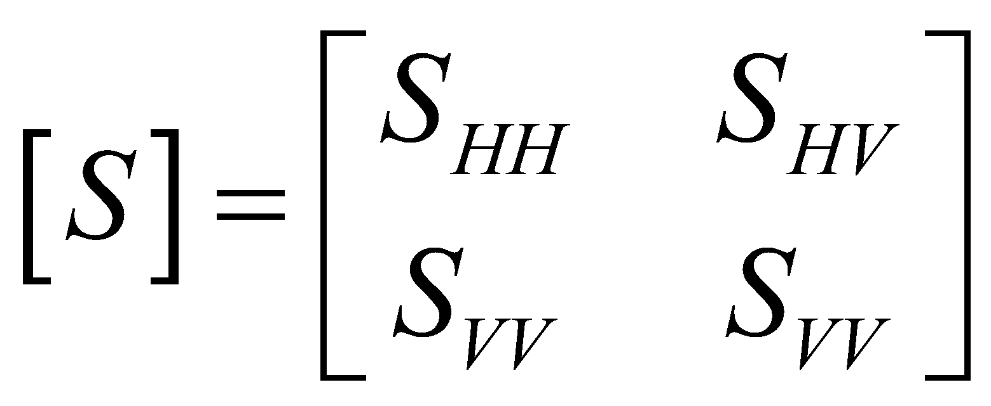
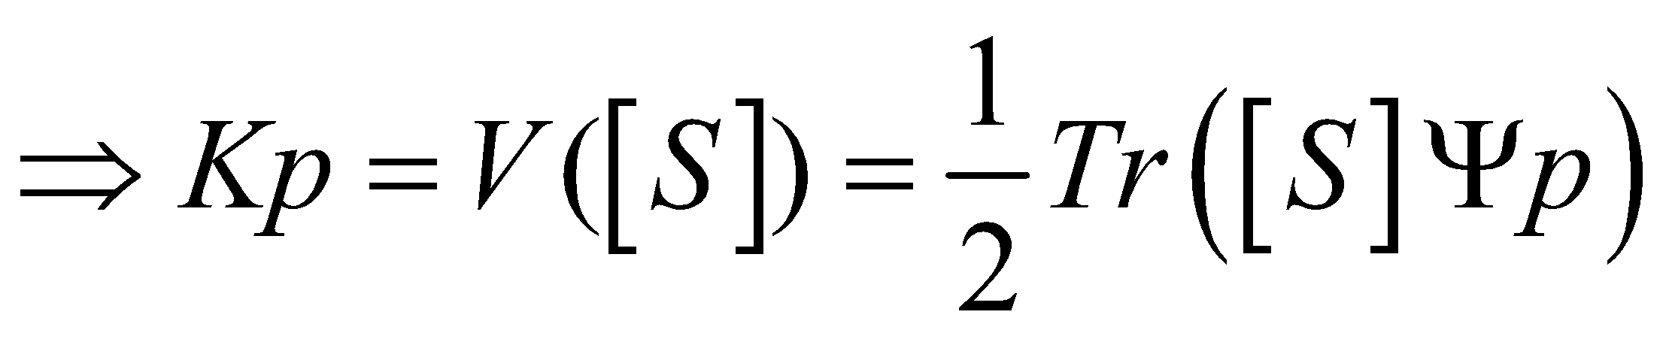
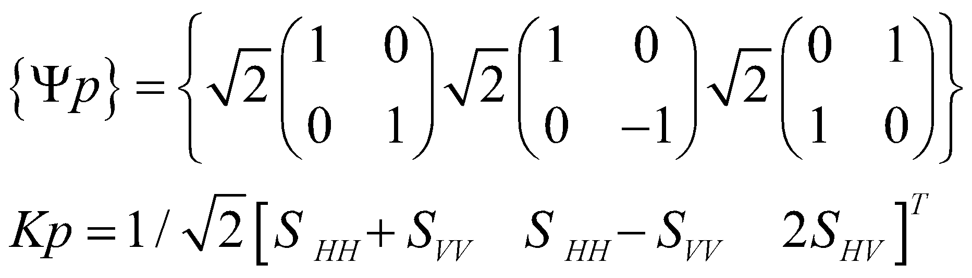
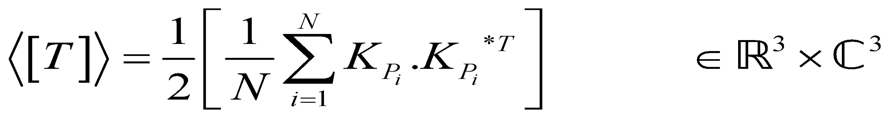
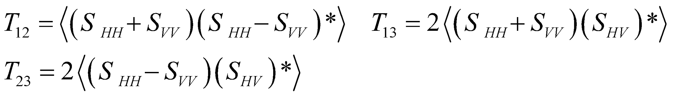
POLSAR Data Representation: Coherency(Pauli)
Deterministic scattering:
Statistical Description:
Diagonal Elements:
Off-Diagonal Elements:

Slide 7
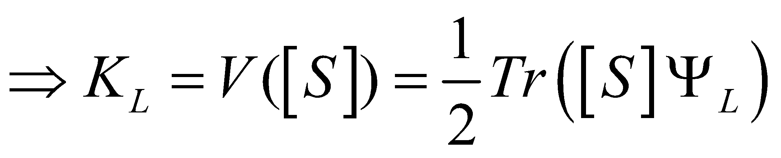
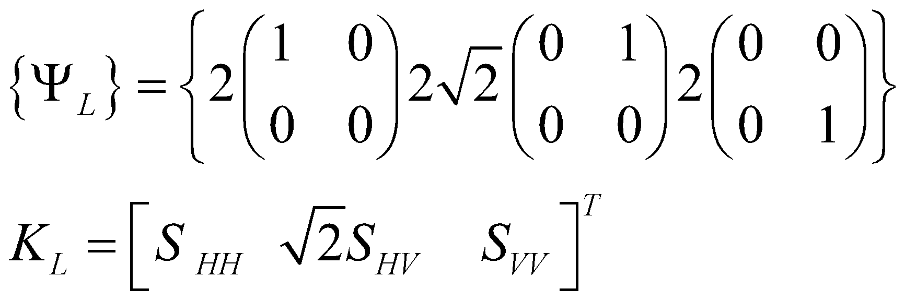

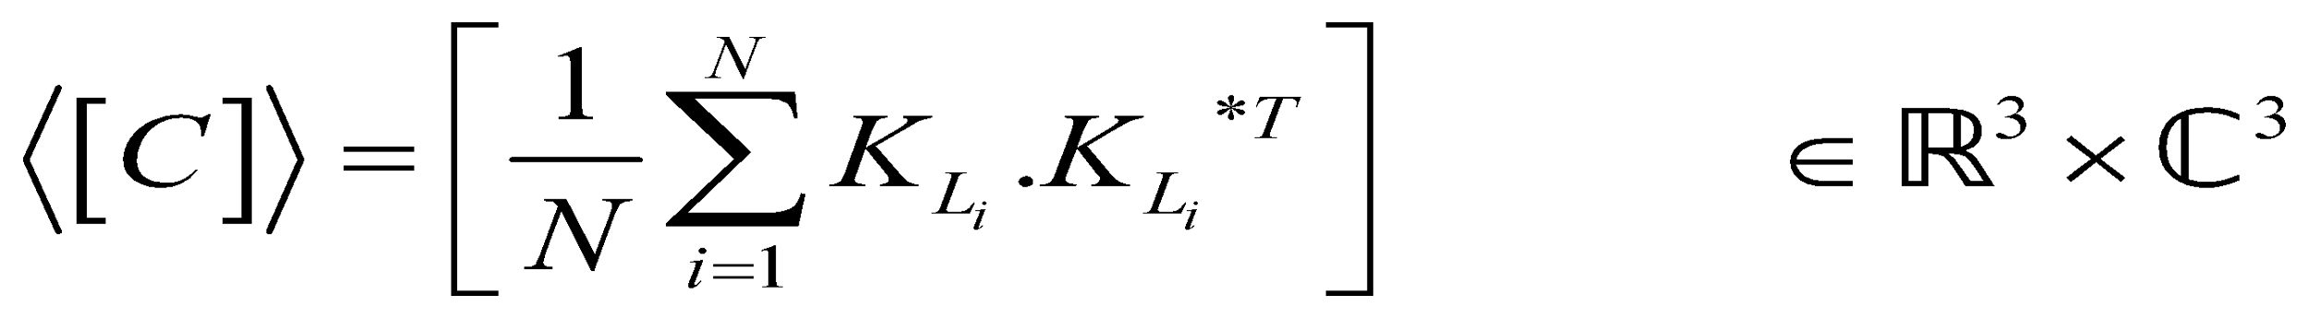
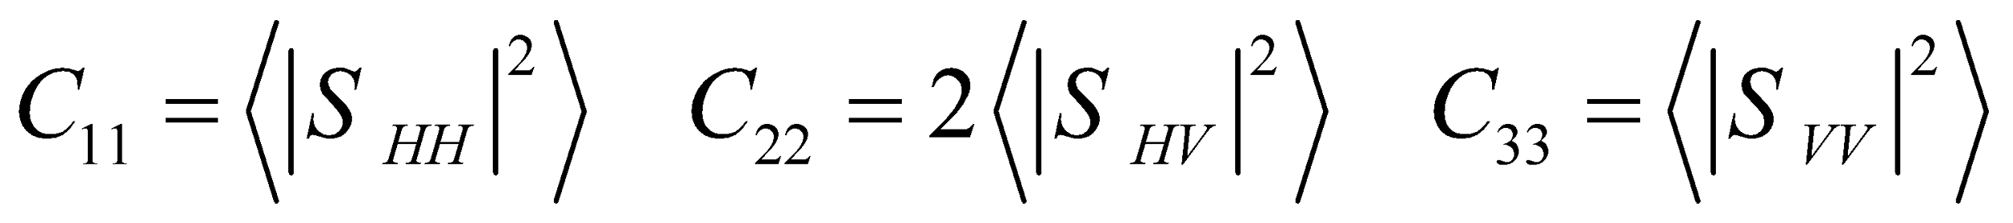
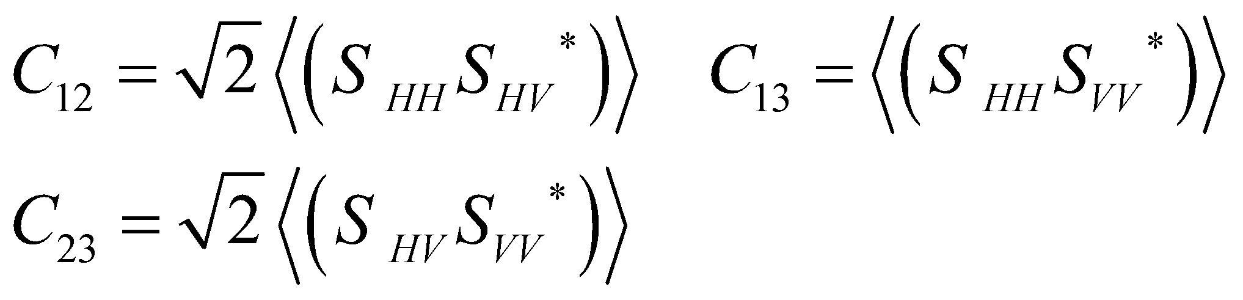
POLSAR Data Representation: Covariance(lexicographic)
Deterministic scattering:
Statistical Description:
Diagonal Elements:
Off-Diagonal Elements:

Slide 8

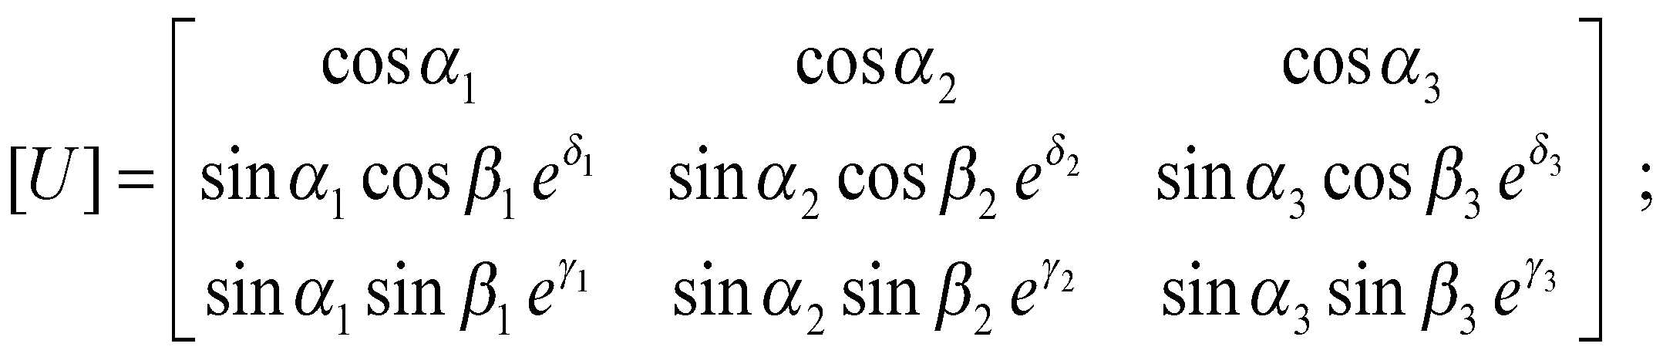
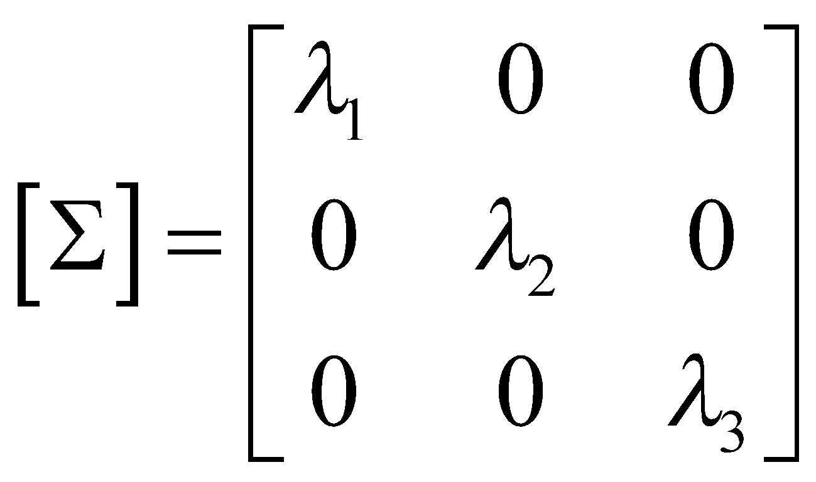
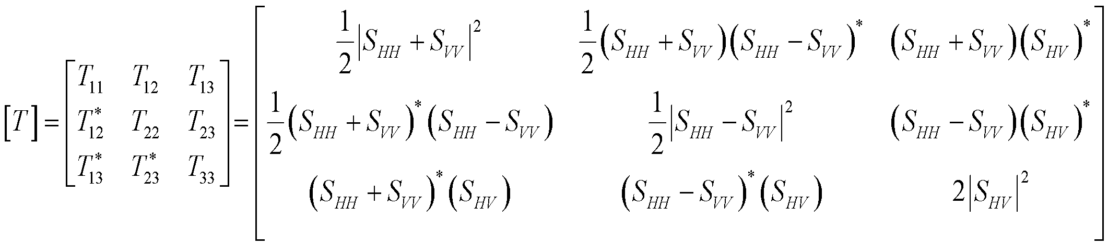
Eigenvector-based decomposition:

Slide 9
Objectives: Comparison Analysis Of The Existing Decomposition Techniques Based on Machine Learning……

Slide 10
Unsupervised Methodology
Unsupervised learning is a machine learning technique that does not monitor the model using training datasets.
Types of clustering algorithms:
Density based
Distribution-based
Centroid-based
Hierarchical-based

Slide 11
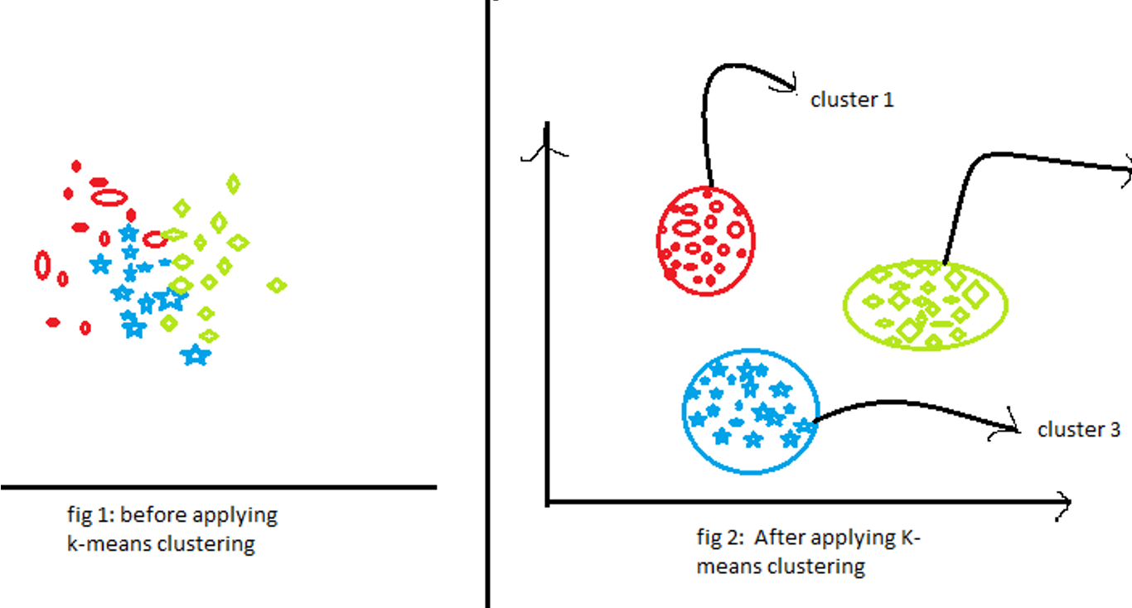
K - Means Clustering Algorithm
What is Clustering ?
Organizing data into classes
Algorithm
Each cluster is associated with a centroid (center point)
Each point is assigned to the cluster with the closest centroid
Number of clusters, K, must be specified
The objective is to minimize the sum of the points to their respective distances centroid

Slide 12
K-means with Normalised dataset
The data set used: San Francisco Polarimetric SAR Datasets(AIRSAR)
K-means algorithm can generate better results after the modification of the databases.
So in this we have feature 1 ,feature 2 and feature 3 datasets after normalization we gave got some better results the K-means algo which are attached in the results.

Slide 13
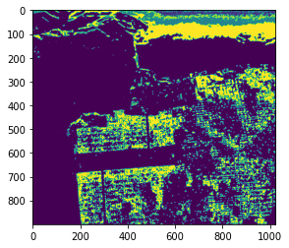
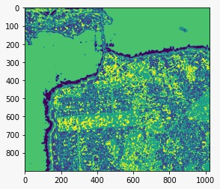
Results
Feature 1 without normalising Feature 1 after normalising the data

Slide 14
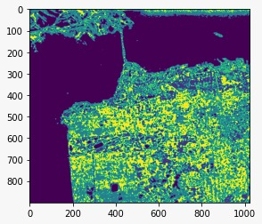
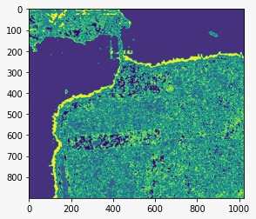
Feature 2 without normalising Feature 2 with normalised data

Slide 15
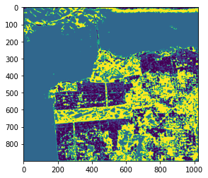
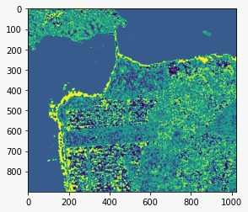
Feature 3 without normalising Feature 3 with normalised data

Slide 16
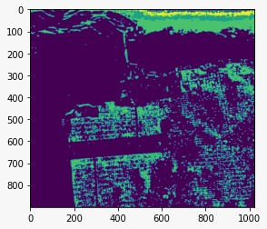
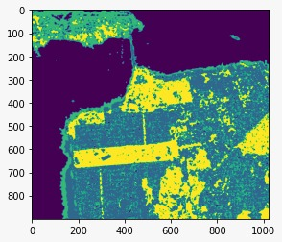
Feature 123(combined) without normalising Feature 123 with normalised data

Slide 17
Supervised Methodology
It is defined by training algorithms that use labeled datasets to classify data and accurately predict results.
This training dataset contains inputs and correct outputs that allow the model to train over time.
Types of Supervised learning:
Classification
Regression

Slide 18
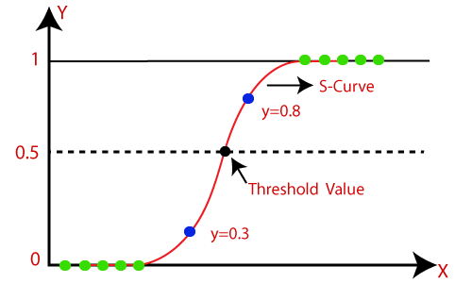
Logistic Regression
Logistic regression is a classification algorithm used to assign observations to individual sets of classes.
It is used to predict categorical dependent variables using a specific set of independent variables.

Slide 19
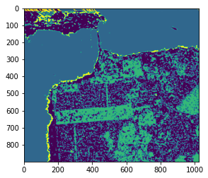
Results
We have applied the supervised algo on normalised dataset .
For normalised feature 1
dataset:

Slide 20
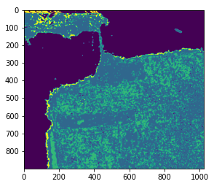
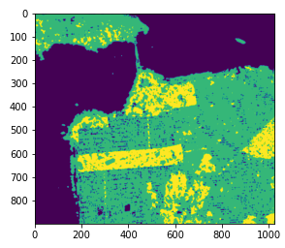
For normalised feature 2 dataset: For normalised feature3 dataset:

Slide 21
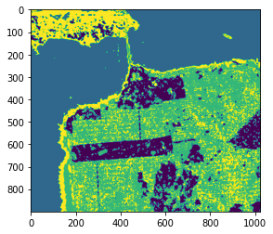
For combined feature1,feature 2 and feature 3 normalised dataset :

Slide 22
Conclusion
From the given raw data set we have improved the results by performing normalisation and then further improved using supervised machine learning.
We have successfully classified the polarimetric image into land , water and vegetation using unsupervised machine learning with a accuracy of 91.125 % .
After applying supervised machine learning to the same data set we get an accuracy of 82.02 %. We can also improve the supervised machine learning results if the features are uniformly distributed in the data set.

Slide 23
Future Scope
The model we have created has a low accuracy for volume scattering data .
By exploring different machine learning algorithms we can further improve the accuracy depending on the type and size of the data set.
Similar to eigenvalue decomposition we can also explore model based decomposition like freeman and yamaguchi .

Slide 24
References
[1] An Entropy Based Classification Scheme for Land Applications of Polarimetric SAR Shane Robert Cloude , Senior Member, IEEE and Eric Pottier, Member, IEEE
[2]A review of Target Decomposition theorems in radar Polarimetry Sham Robert Cloude, Member, IEEE, and Eric Pottier, Member, IEEE
[3]Polarimetric Radar Imaging Founding Editor Brian J. Thompson University of Rochester Rochester, New York
[4] Freeman, A. and S. L. Durden, “A three-component scattering model for polarimetric SAR data," IEEE Transactions on Geoscience and Remote Sensing, Vol. 36, No. 3, 963-973, 1998.

